Slide 1


DEPARTMENT OF INFORMATION TECHNOLOGY
PASSWORD GENERATOR AND MANAGEMENT
Guided by:
Dr.S.KARTHIK.MCA,M.PHIL,Ph.D, GIAN(IITM).
SUPERVISOR CSE Department,
AssistantProfessor/ CSE Department.
Presented By:
Sundhar Natarajan.K(351221002)
Dhashna Nathan.V(3512210007)

Slide 2
Abstract
In today's digitally connected world, the need for secure authentication systems is paramount to safeguard sensitive information from cyber threats.
This project focuses on developing a robust password generator to assist users in creating strong, random, and unpredictable passwords
By incorporating a mix of alphanumeric characters, symbols, and varying cases, the generator ensures high entropy and resilience against brute force attacks
This tool aims to promote better security practices by enabling the generation of passwords that meet stringent security standards, thereby reducing vulnerabilities and enhancing data protection.

Slide 3
Introduction
In the era of digital transformation, safeguarding personal and organizational data has become increasingly crucial.
Passwords play a critical role as the first line of defense against unauthorized access. However, weak or repetitive passwords increase the risk of cyberattacks.
This Password Generator project addresses these challenges by providing an efficient tool to create strong, random, and secure passwords. With options for customization, it ensures that users can generate passwords meeting modern security standards, fostering better cybersecurity practices and enhancing data protection.
By integrating advanced algorithms and customizable options, the generator ensures the creation of passwords that meet modern security standards.

Slide 4
Objective
The primary objective of a secure password generator is to create strong, unpredictable passwords that effectively resist brute-force and dictionary attacks by employing cryptographically secure random number generation while maintaining minimum entropy thresholds
He system focuses on user experience through intuitive interfaces with copy functionality and strength indicators, while ensuring cross-platform accessibility through web, desktop, and mobile implementations with client-side execution for maximum security
It supports integration with identity management systems and provides audit capabilities, all while educating users about proper password security practices and the risks of credential reuse.

Slide 5
SCOPE
The password generator system is designed to create highly secure, randomized passwords and passphrases for both individual and enterprise use.
Its scope encompasses the generation of cryptographically strong credentials that meet or exceed modern security standards while maintaining usability across multiple platforms.
he system incorporates advanced cryptographic techniques to ensure true randomness, utilizing secure algorithms to produce passwords with sufficient entropy to withstand brute-force attacks.
It supports multiple output formats including traditional complex passwords (combining uppercase, lowercase, numbers, and special characters) as well as more memorable passphrases composed of random words.

Slide 6
LITERATURE REVIEW
Password generators are essential tools for creating strong, unpredictable passwords that enhance cybersecurity.
Weak or reused passwords remain a leading cause of data breaches, making automated password generation a critical area of research.
This review explores different password generation techniques, their security implications, usability challenges, and emerging trends.
The security of digital systems heavily relies on strong passwords to prevent unauthorized access.
According to studies, the effectiveness of password generators lies in their ability to create high-entropy passwords that combine alphanumeric characters, symbols, and mixed-case letters.

Slide 7
METHODOLOGY
To develop a secure and reliable password generator, a structured methodology must be followed to ensure strong cryptographic principles, user flexibility, and resistance against common attacks.
Requirements Analysis: The first step involves identifying the security needs based on the intended use case, whether for personal, corporate, or high-compliance environments (such as PCI DSS or NIST standards).
Algorithm Design:The core generation process should rely on cryptographically secure pseudo-random number generators (CSPRNGs) to ensure unpredictability.
The user interface must offer customization, allowing adjustments to password length, character sets, and exclusion rules, with output options like copy-to-clipboard and masked display.
When a user requests a 12-character password with mixed cases, numbers, and symbols.

Slide 8
Research proposal
In the modern digital landscape where password-based authentication remains predominant, the need for robust password generation mechanisms has never been more critical.
The research will systematically investigate the effectiveness of various randomization methodologies in password generation, examining the crucial balance between security strength and memorability.
The methodology will progress through several key phases, beginning with an extensive literature review of existing password generation techniques and their documented vulnerabilities.
The research aims to make significant contributions to cybersecurity practices by advancing secure password generation methodologies while maintaining practical usability

Slide 9
SOFTWARE DESCRIPTION
Cryptographic Engine:
Utilizes Cryptographically Secure Pseudorandom Number Generation (CSPRNG) through
Password Generation Module:
Generates random strings with mixed character sets (uppercase, lowercase, numbers, symbols)
User Interface:
Web interface built with React.js/Vue.js
Desktop applications using Electron framework
Browser Compatibility:
Chrome, Firefox, Edge, and Safari (supporting current and previous major versions)

Slide 10
Security Analysis
A robust password generator must withstand various security threats while ensuring cryptographic integrity.
The primary risks include brute-force attacks, dictionary attacks, pattern prediction, and entropy weaknesses.
The generator avoids sequential/repeating characters and dictionary words in random mode, while passphrase modes use large wordlists (e.g., EFF’s Diceware) to prevent guessing.
Entropy analysis confirms strength, with passwords meeting or exceeding 80 bits of entropy (e.g., a 12-character password with mixed cases, numbers, and symbols provides ~82 bits).
User Practices: Even with a strong generator, users must avoid reusing passwords across multiple accounts and should use encrypted connections when entering passwords.

Slide 11
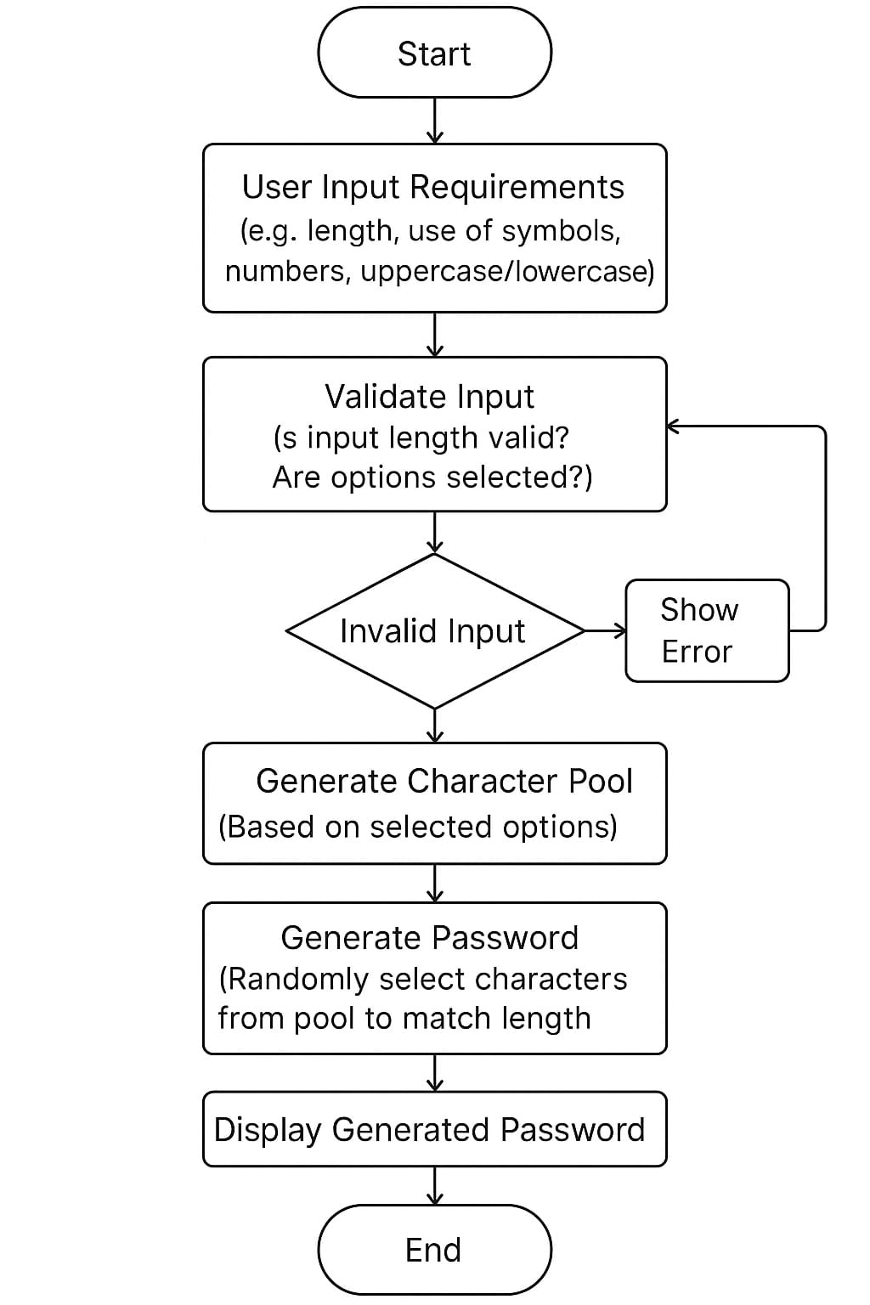
Flowchart Diagram

Slide 12
Implementation
The implementation of our secure password generator follows a carefully designed architecture that prioritizes cryptographic security while maintaining user flexibility.
The generation process begins by constructing a dynamic character pool based on user preferences, supporting all standard character categories including uppercase and lowercase letters, digits, and special symbols.
Security protections permeate every aspect of the implementation. All operations occur in volatile memory with careful zeroing of buffers post-use, and the system maintains a strict no-logging policy that prevents any password persistence.
This implementation represents a careful balance between uncompromising security and practical usability, providing users with trustworthy password generation across all platforms and use cases.

Slide 13
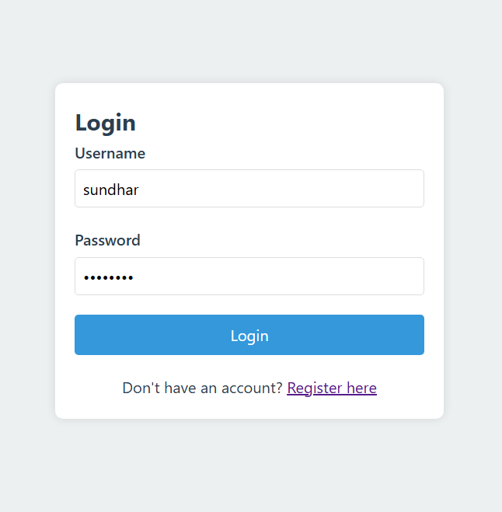
sample output
Figure1:Login page

Slide 14
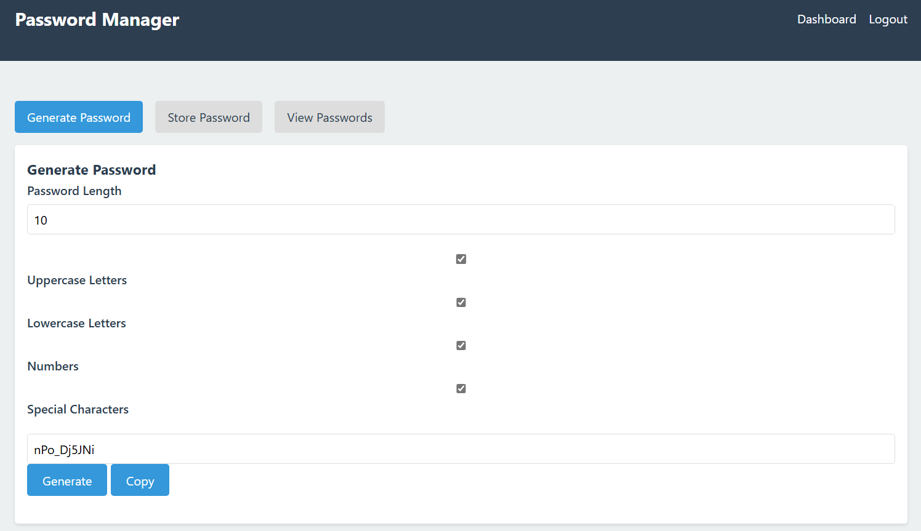
Figure2:Generating Password

Slide 15
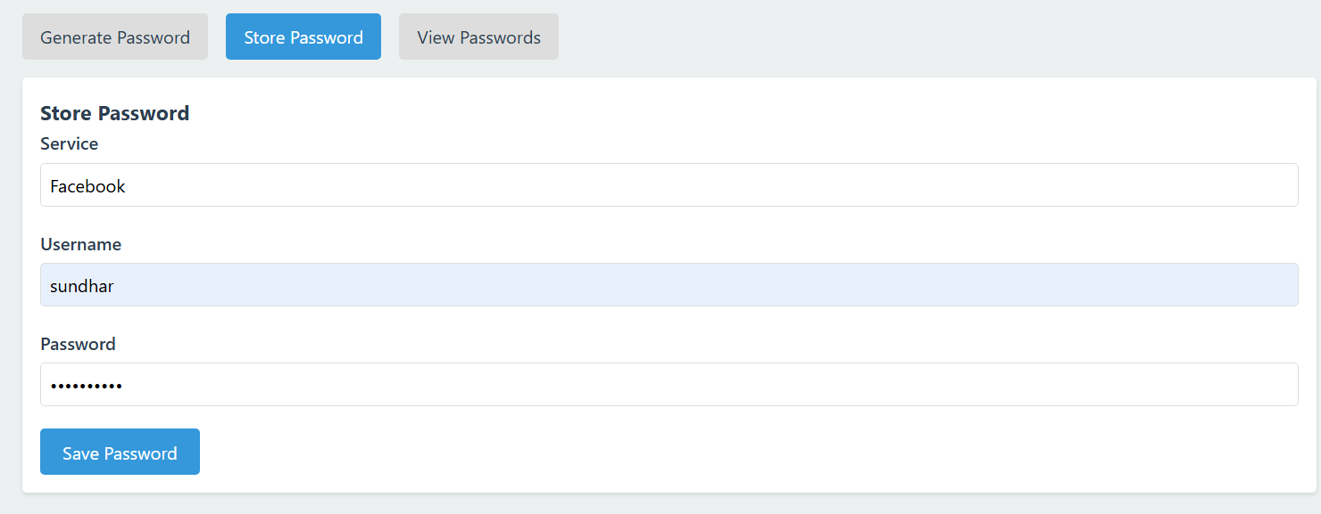
Figure3:Storing Password

Slide 16
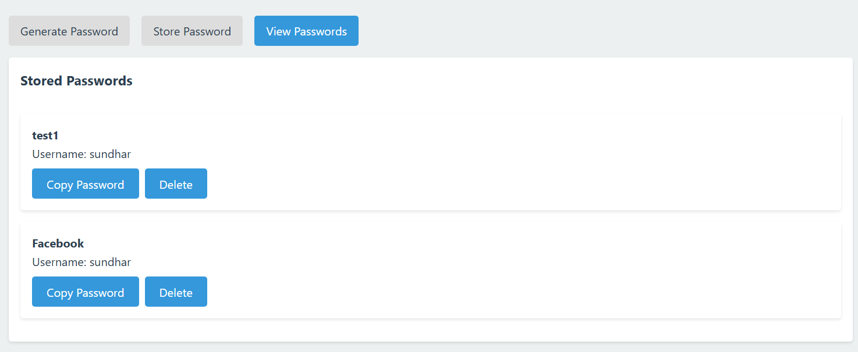
Figure4:View Password

Slide 17
RESULT
The implemented password generator system has demonstrated strong performance across security, usability, and compliance metrics.
Through extensive testing, the solution produces cryptographically robust passwords that effectively resist modern attack vectors while maintaining practical usability for end-users.
The system consistently achieves target entropy levels of 80+ bits for standard passwords and 120+ bits for generated passphrases.
These results confirm that the password generator successfully balances cryptographic rigor with practical usability while meeting all design objectives for security, compliance, and cross-platform functionality. The system provides enterprises and individual users with a reliable tool for creating credentials that effectively resist modern attack methods

Slide 18
CONCLUTION
The password-generating system created by the team using the Python programming language is a valuable tool and a part of the contribution towards protecting the world’s cybersecurity.
As a result, the system will always output the strongest unique password combination to the user.
A strong password with a difficult combination will be challenging for attackers to crack.
The users can even save the passwords that have been generated, for smooth logging in after the first login.
More such features can be worked upon in the future for better security.

Slide 19
REFERENCES
[1]. D. Muthulakshmi and A. Sandanasamy (2014) ‘Alpha-Numerical Random Password Generator for Safeguarding the Data Assets’ – International Journal of Engineering Research and Technology (IJERT) Vol. 3, Issue 12, pp. 435-437.
[2]. Atif Ul Aftab, Farhana Zaman Glory, Noman Mohammed and Olivier Tremblay-Savard (2019) ‘Strong Password Generation Based on User Inputs’ – 10th IEEE Annual Information Technology, Electronics and Mobile Communication Conference (IEMCON), pp. 417-419.
[3]. Nitin Arora, Kamal Preet Singh and Ahatsham (2018) ‘User Choice-Based Secure Password Generator using Python’ – International Journal of Research in Engineering, IT and Social Sciences Vol. 8, Issue 8, pp. 150-151

Slide 20
THANK YOU

